Slide 1
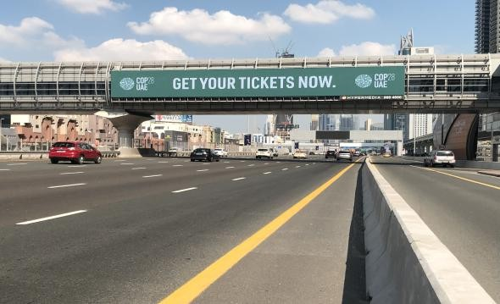







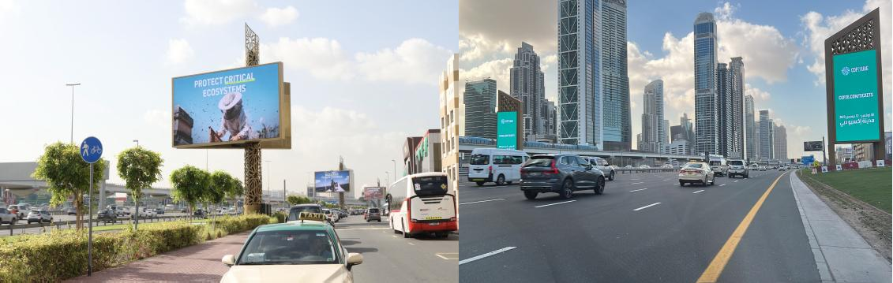
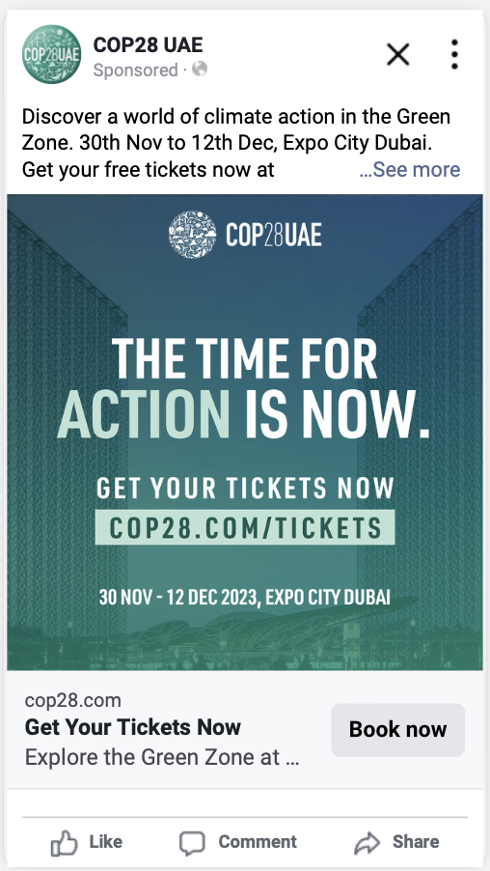
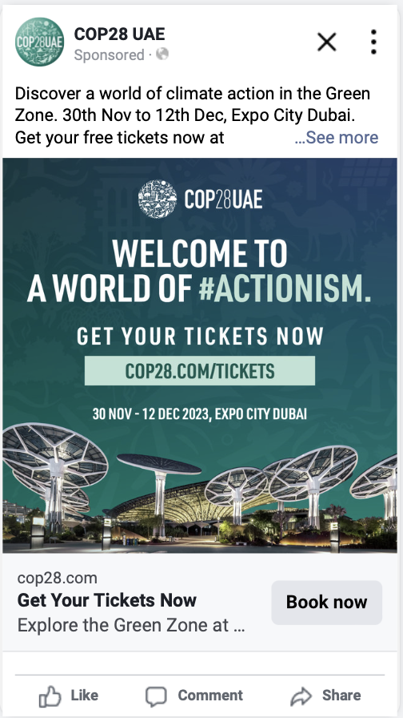
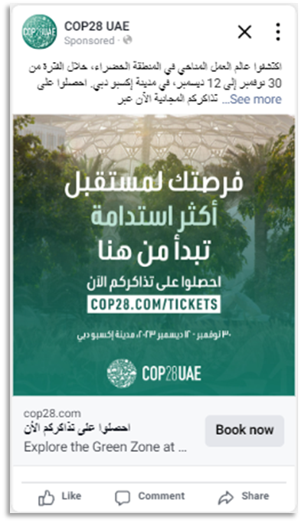
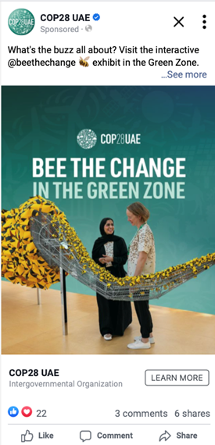
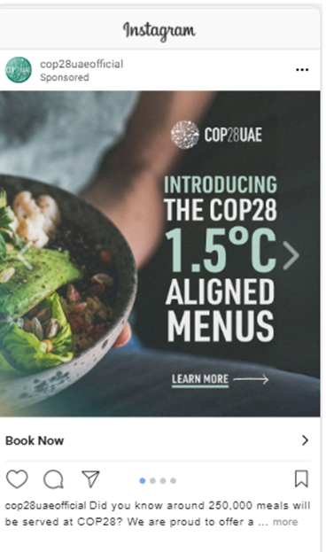
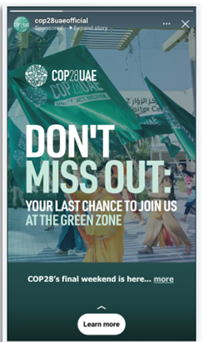
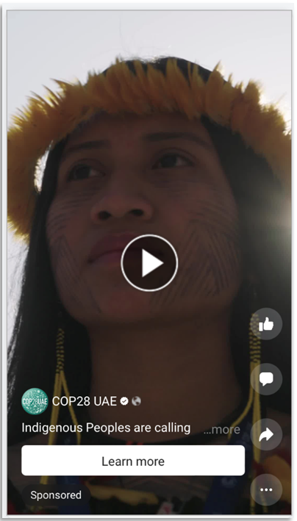
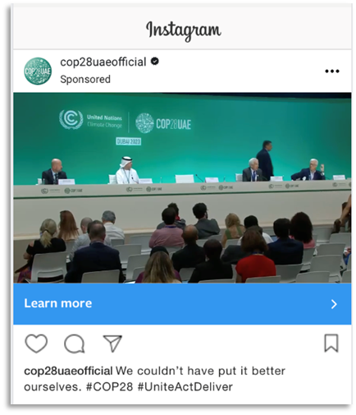
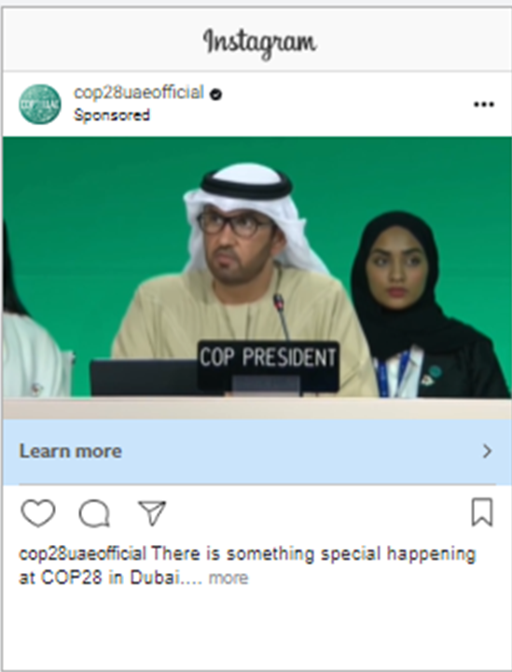
COP28 | Integrated Media Activation
Driving nationwide awareness and Green Zone visitation through coordinated physical and digital touchpoints
Mass Visibility & Credibility
High-impact DOOH placements across Dubai's key arterial routes and business districts to establish scale and legitimacy
Intent Capture & Conversion
Geo-targeted digital activity around Expo Dubai and high-traffic locations to convert interest into ticket purchases
Target Audience:
UAE residents and tourists
Coverage:
All of UAE + Geo-targeting Expo Dubai parameters
Delivery
298M+ Impressions
15.2M Reach
1.3M Clicks
Success Metrics
11% increase on planned impressions
8% Increase on planned reach

Slide 2
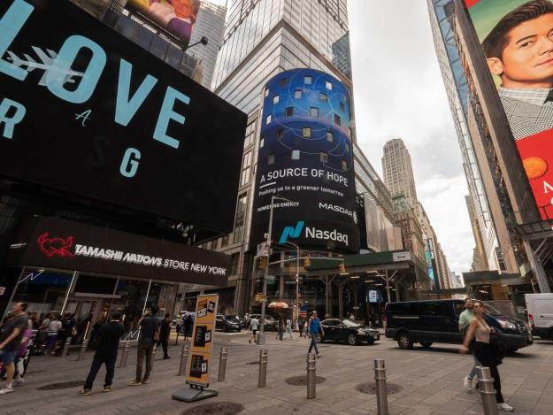
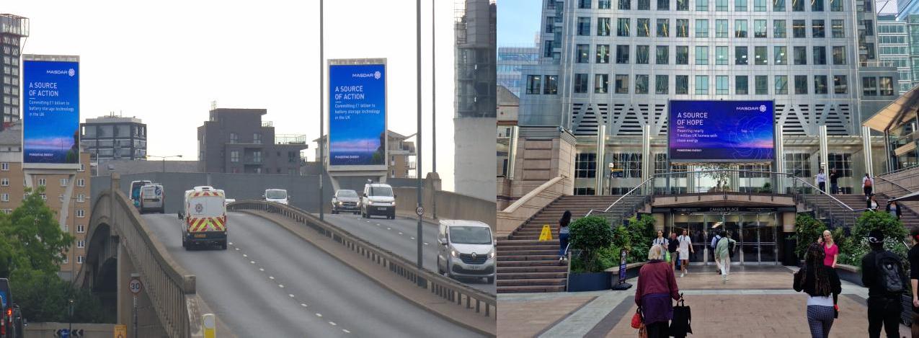
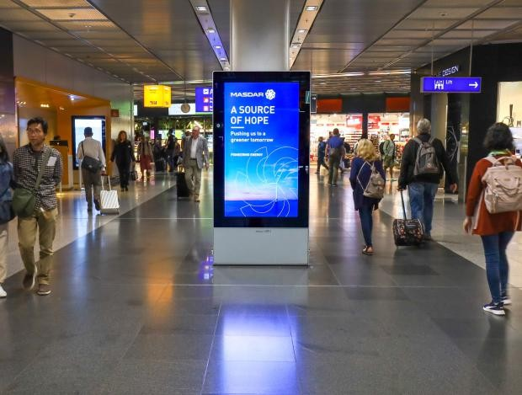
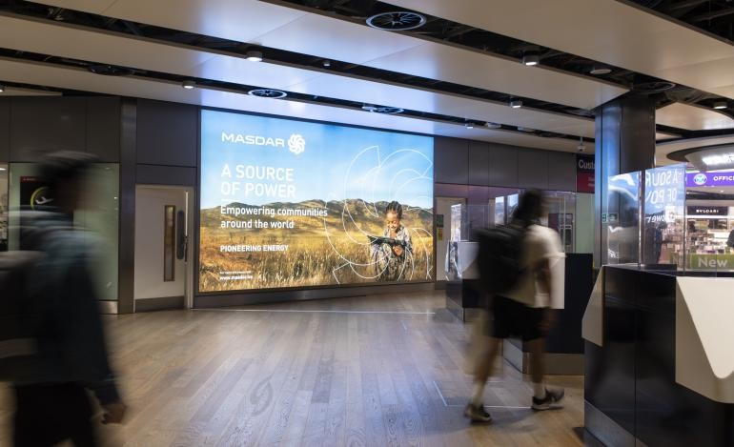
Masdar – Global Outreach
Objective Build awareness of Masdar’s rebrand at a regional and global level
Global Brand Presence
Strategically placed branding across high-impact airport and OOH environments to establish Masdar’s leadership in sustainability on a global stage
Digital Amplification & Performance
Digital and social campaigns deployed to extend reach, drive engagement, and generate qualified traffic across priority markets
Coverage:
USA (JFK & Washington), KSA (Riyadh & Jeddah), Paris-CDG, London – Heathrow, Germany – Frankfurt, Indonesia- Jakarta, London (Canary Warf), Kenya, NewYork
Overall Impressions delivered
383,493,319
Overall clicks delivered
397,914
Overall views delivered
64,406,021
Reach achieved
88,639,019

Slide 3
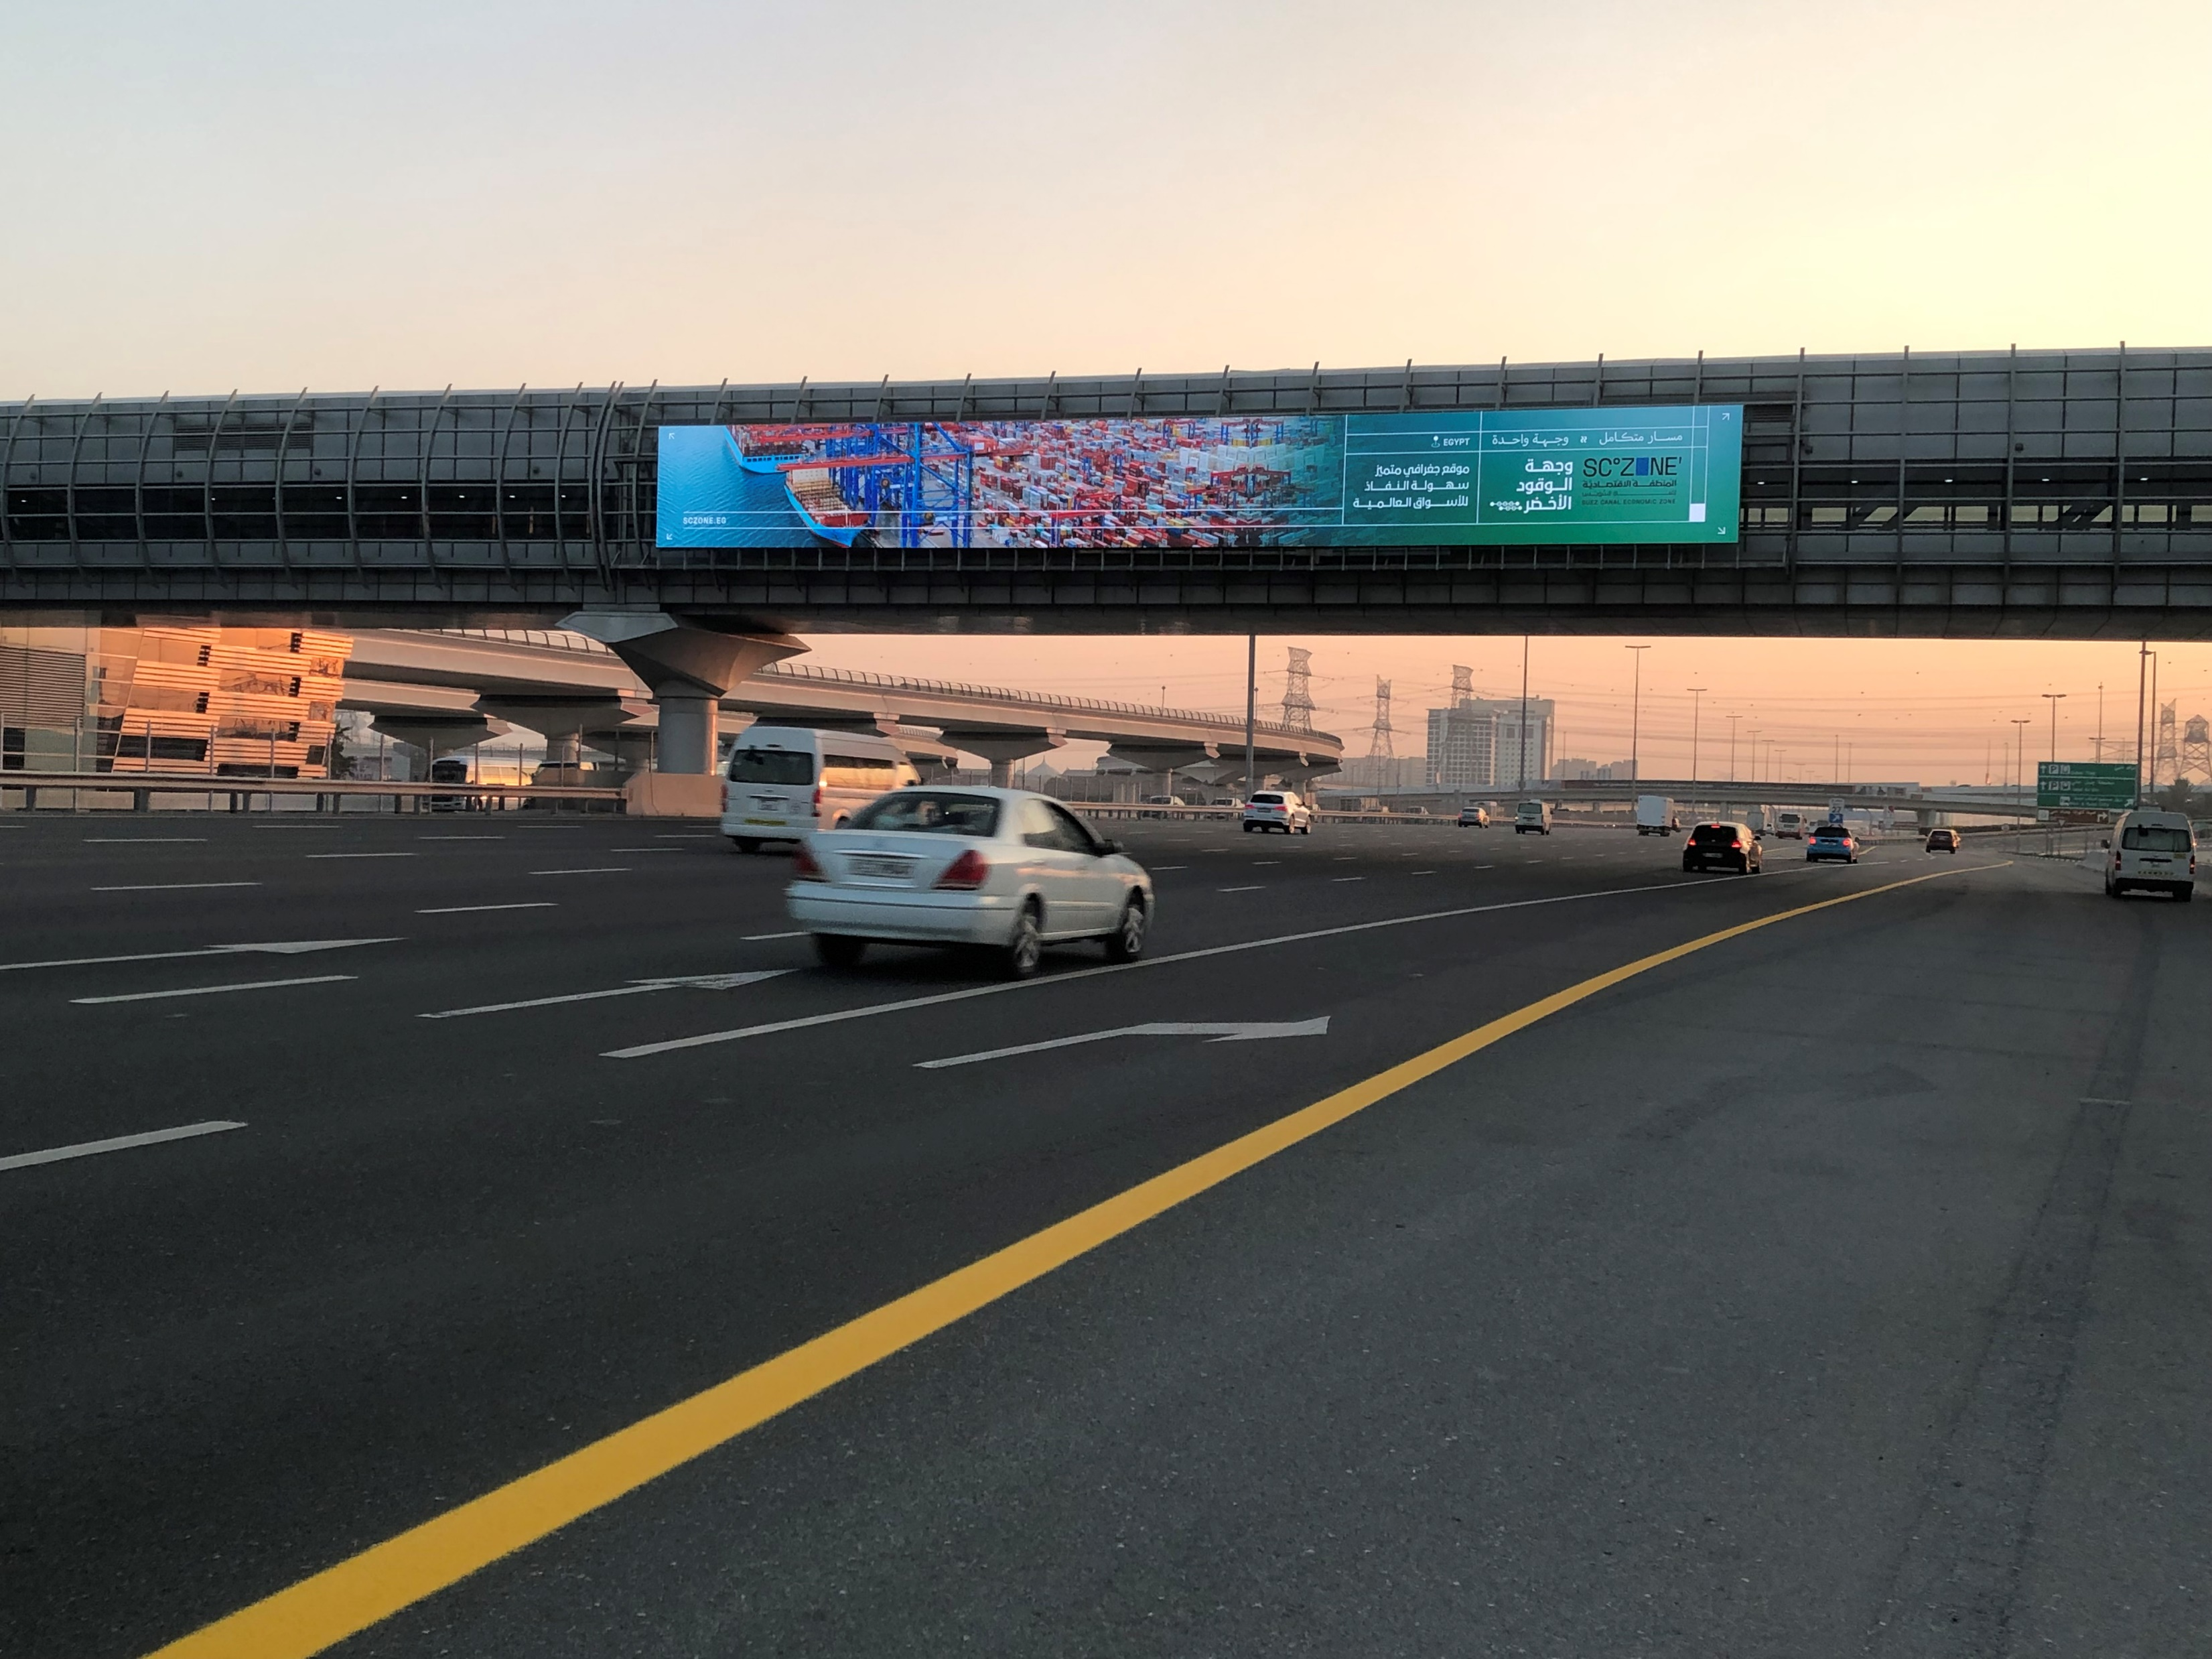
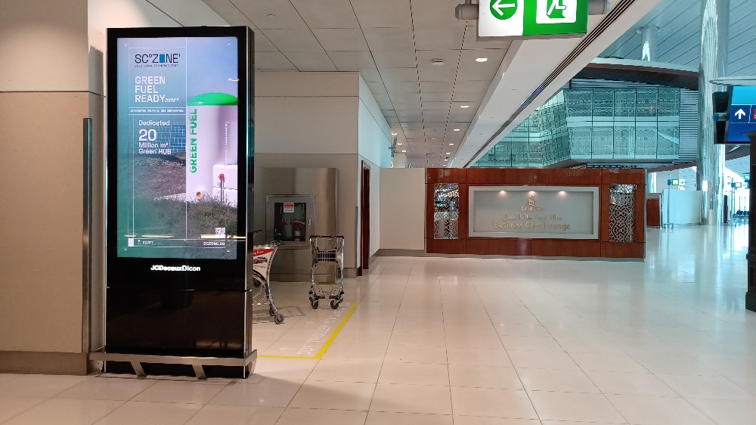
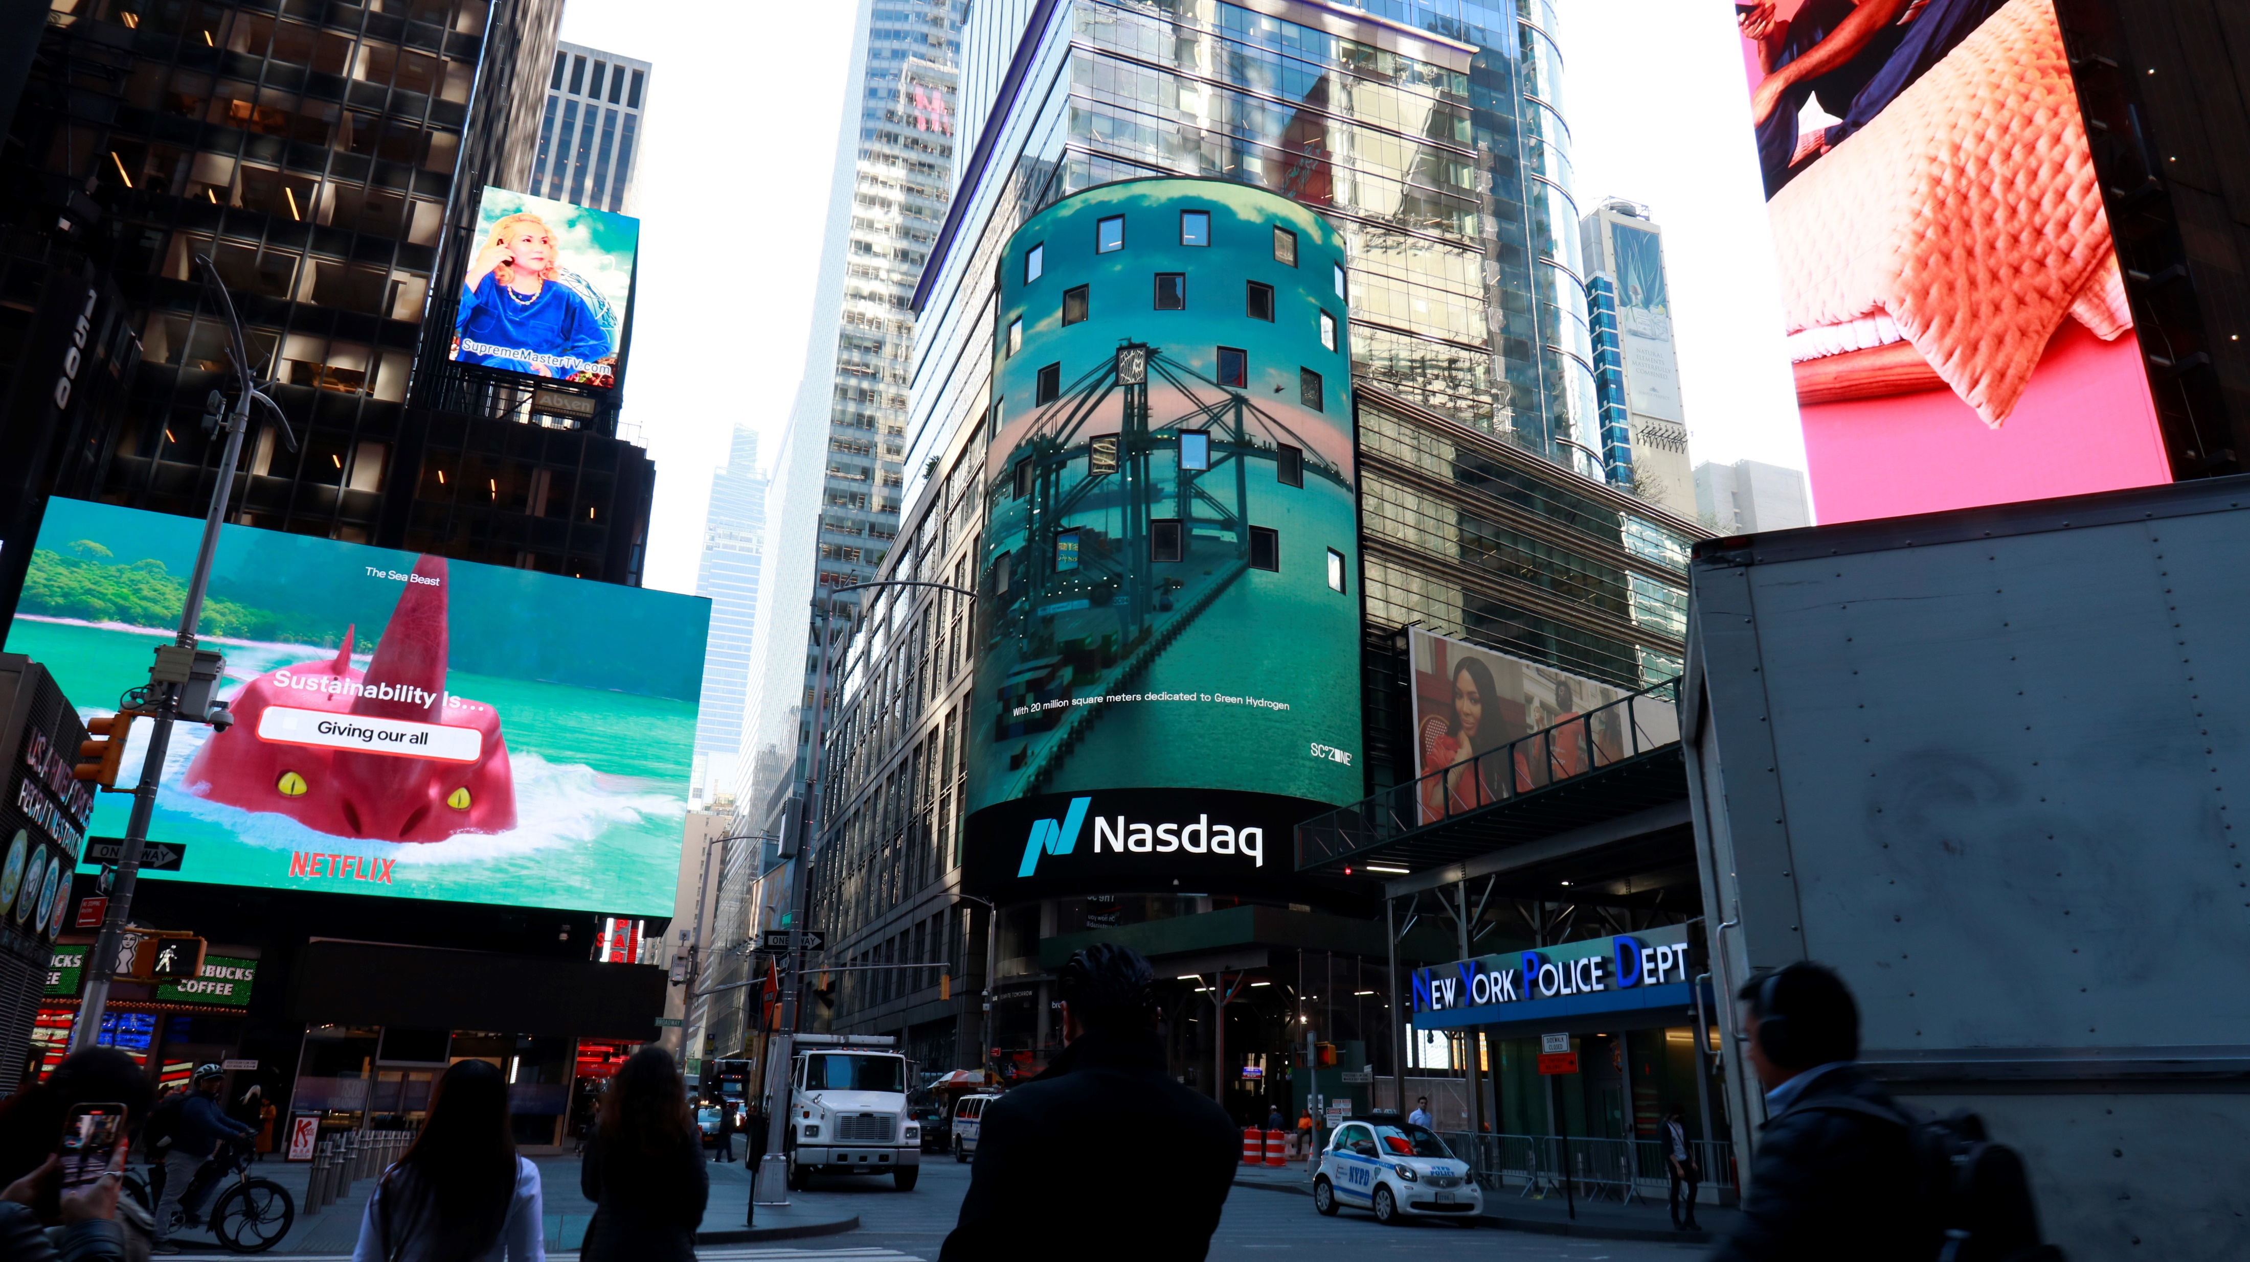
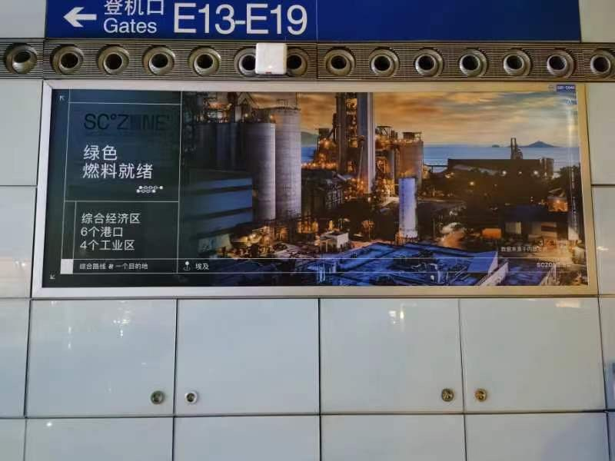
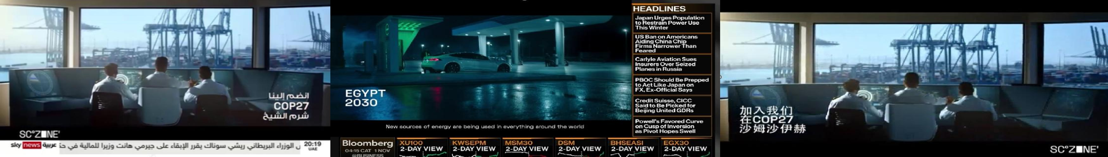
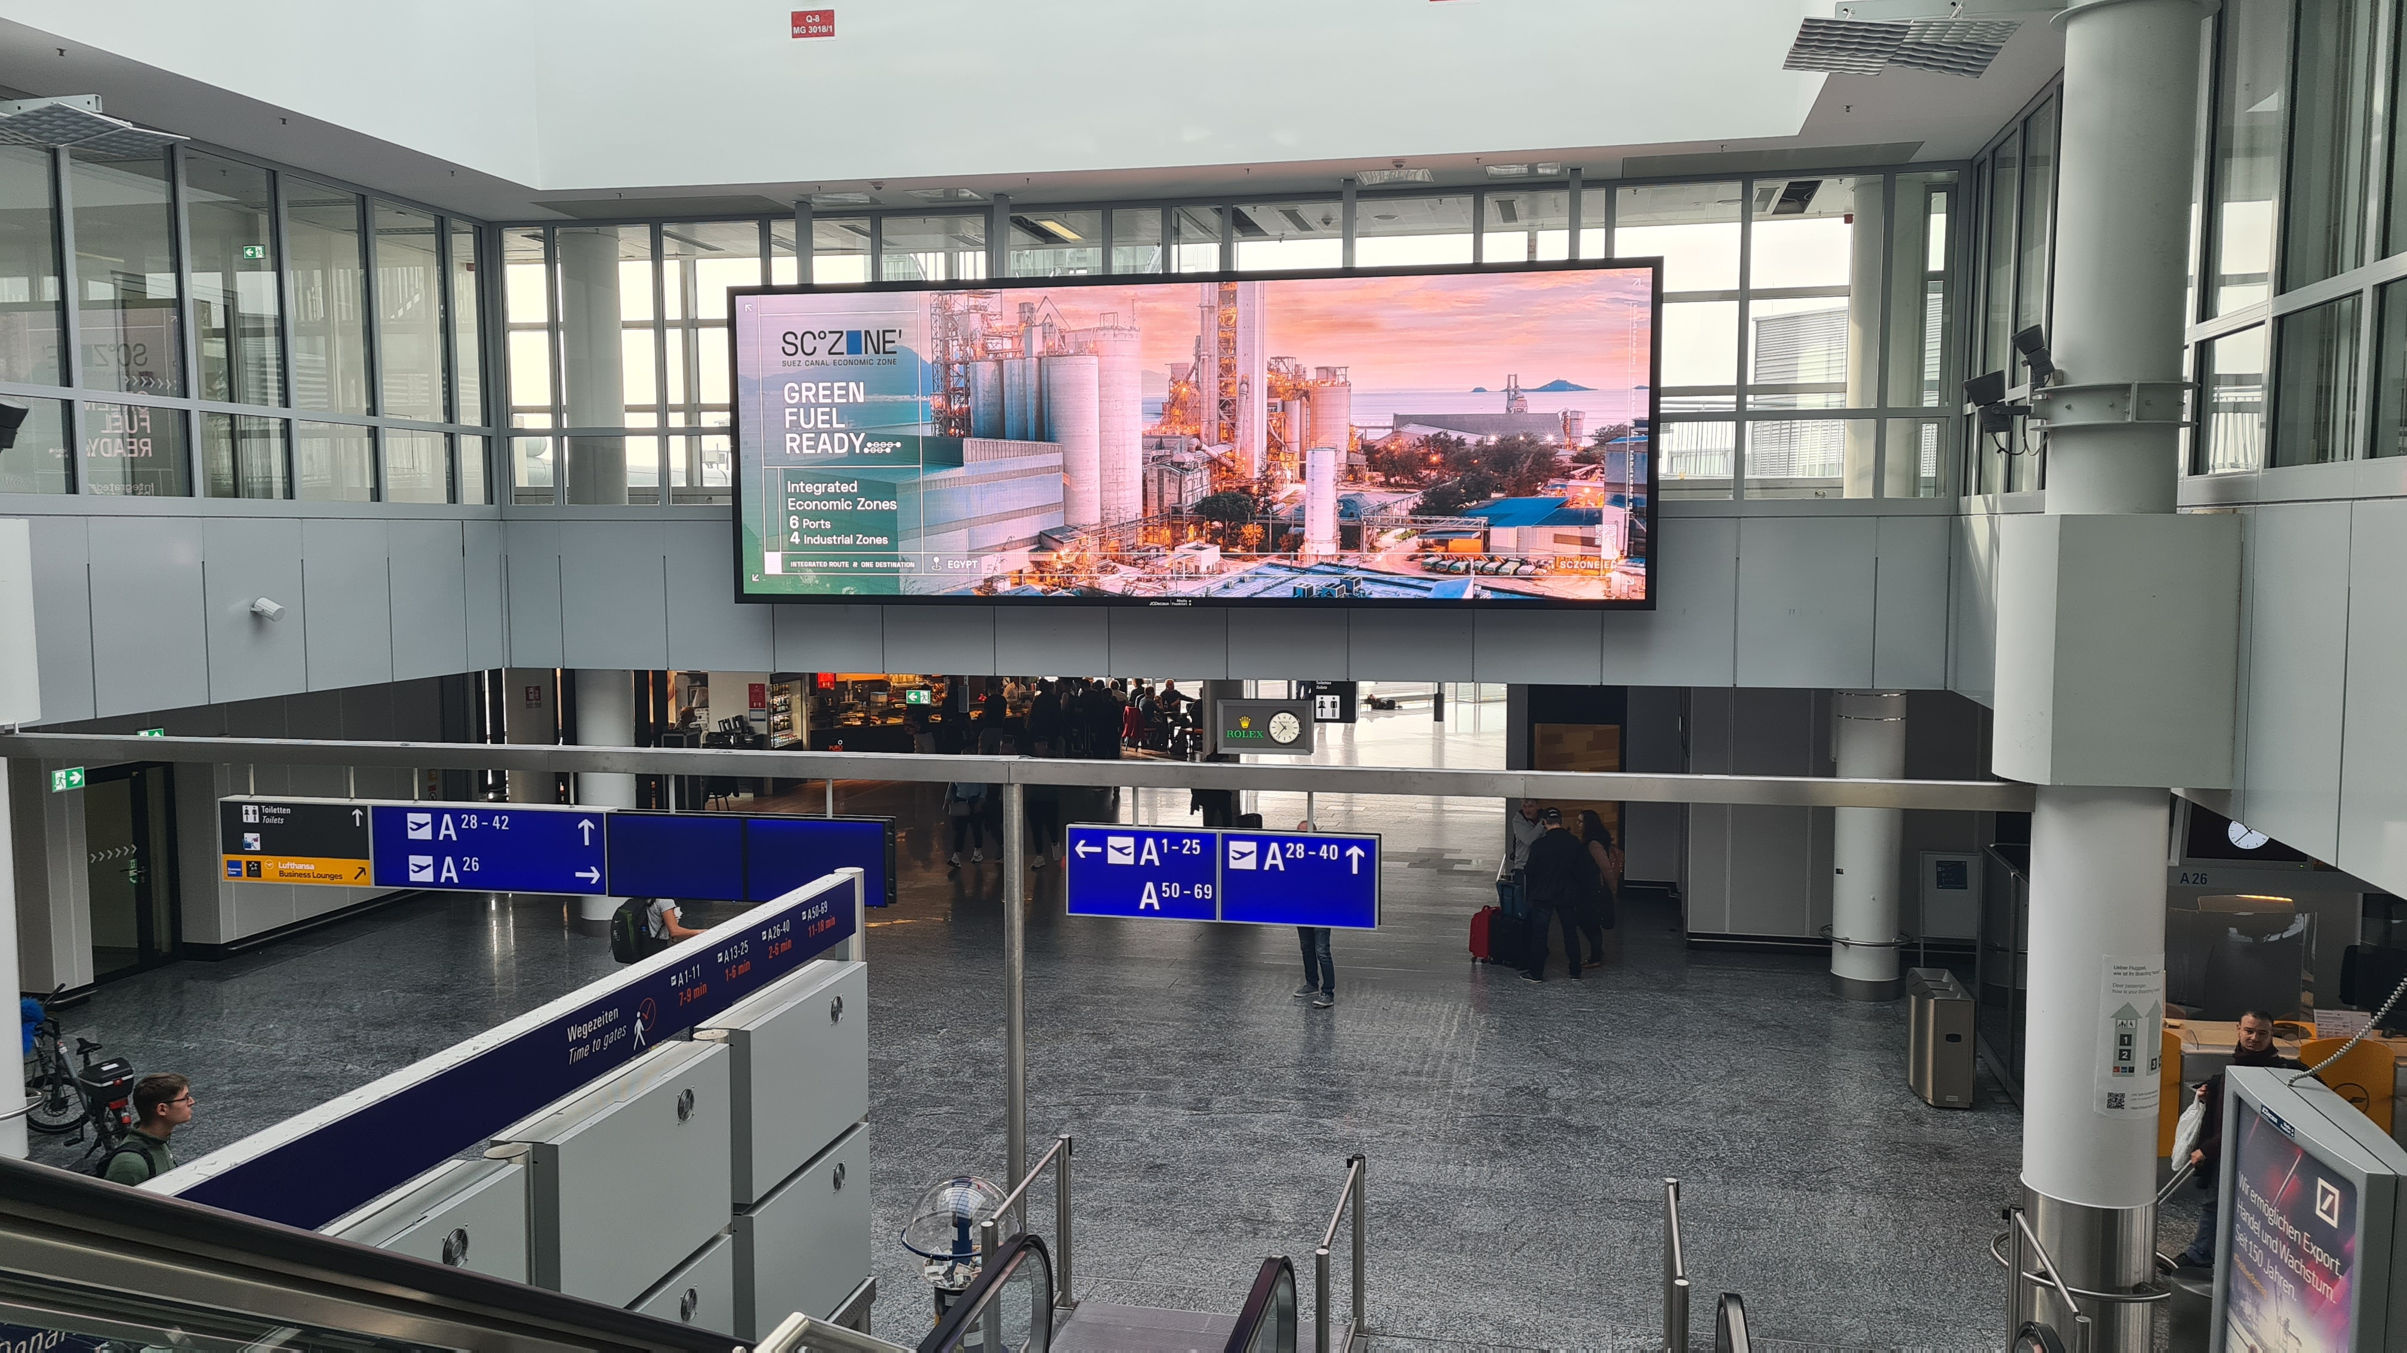
SCZONE
Strengthen awareness and visibility of SCZone among global and regional business audiences through high-impact business-focused television programming as part of COP27 activities.
Execution Approach
Selective presence across leading international and regional television news networks, with a focused placement strategy within business and economy-related programming aligned to the target audience’s interests.
Strategic coverage across primary markets namely UAE, France, Germany, UK, USA and China
Utilizing out of home assets as well the countries’ capital airports to raise awareness and invite participation during COP27 namely; Dubai International Airport, Paris Charles de Gaulle Airport, Frankfurt Airport, London Heathrow Airport, JFK International Airport and Beijing Capital International Airport
,

Slide 4
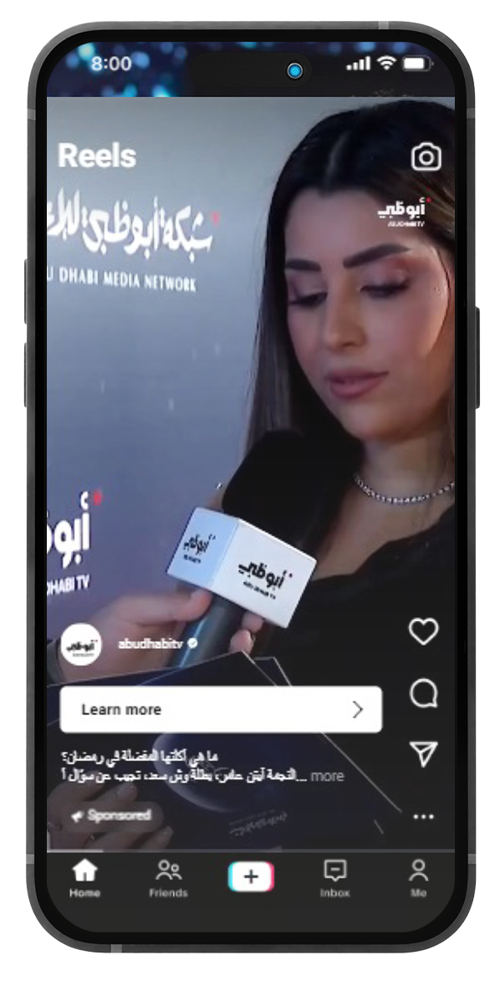
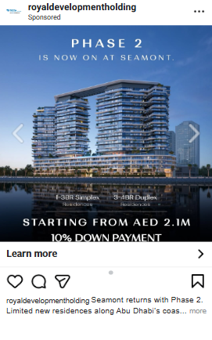
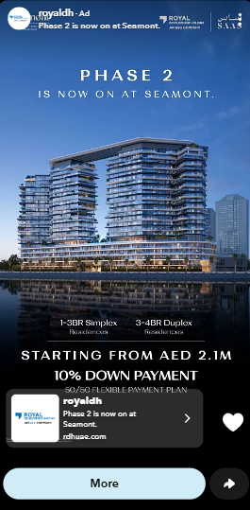

RDH
Campaign Objectives:
Launch RDH as a new entity in the UAE market by introducing its vision, mission, and unique value proposition to target audiences.
Target audience:
Focus on users aged 28–60 with interests in property, home design, or life events like moving and geo-target affluent areas for better lead quality..
Execution:
Create pre-launch buzz, then scale awareness through a multi-platform rollout combining storytelling, audience targeting, and localized creative for both corporate and public audiences.
Coverage:
UAE, UK, and South Africa
Overall clicks delivered
600,241
Engagement Rate
2.19%
15% Higher than industry benchmarks
Total Impressions
156,764,715
TOTAL VIEWS
12,200,569

